Slide 1
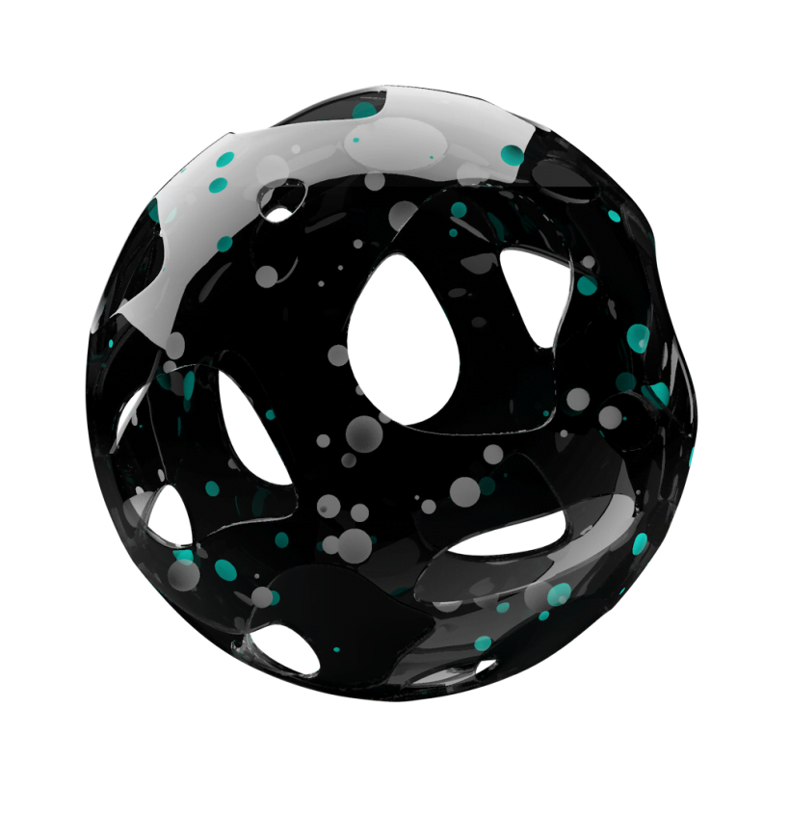
Privacy
And
Voice Screening
For Environmental Sound Identification

Slide 2
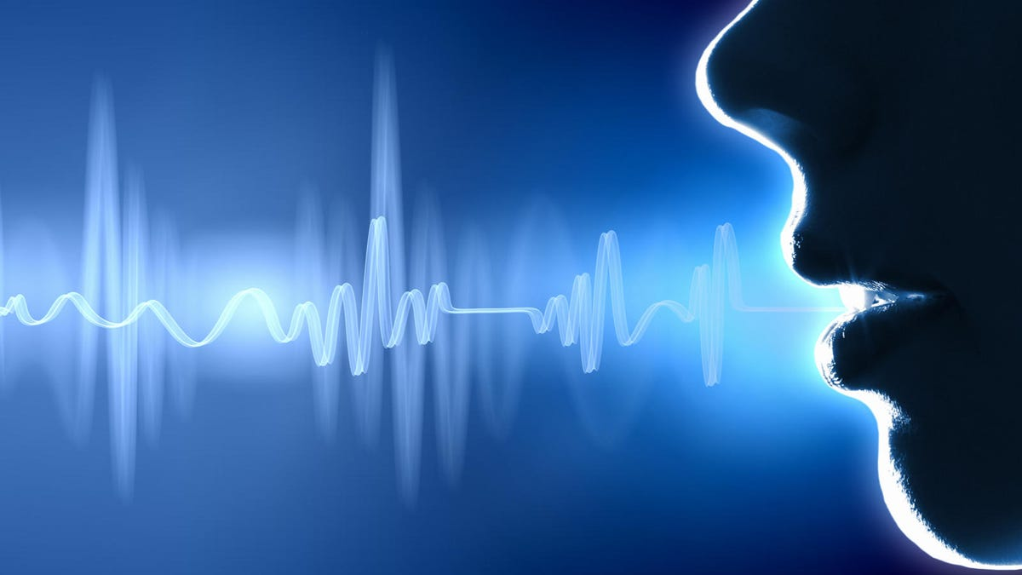
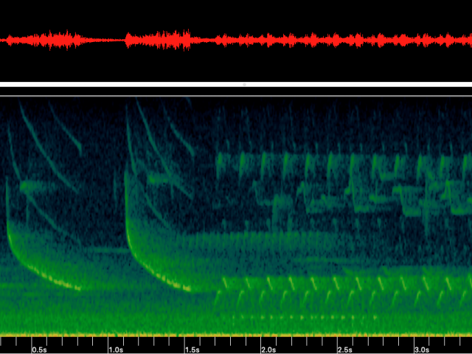
The Privacy Problem
How would you feel
if a private conversation was recorded
without your consent?
Notes:
Imagine you’re on holiday with your partner or your family. You have your own little corner of bush, no one else around. You relax, explore, spend time together. Then, one month later, you find out that your conversations were recorded and someone’s listened to them.
How would you feel? … Most people would be uncomfortable with this, because it’s a violation of privacy. But it’s something that currently happens, because of a relatively new field called “environmental sound identification”.

Slide 3
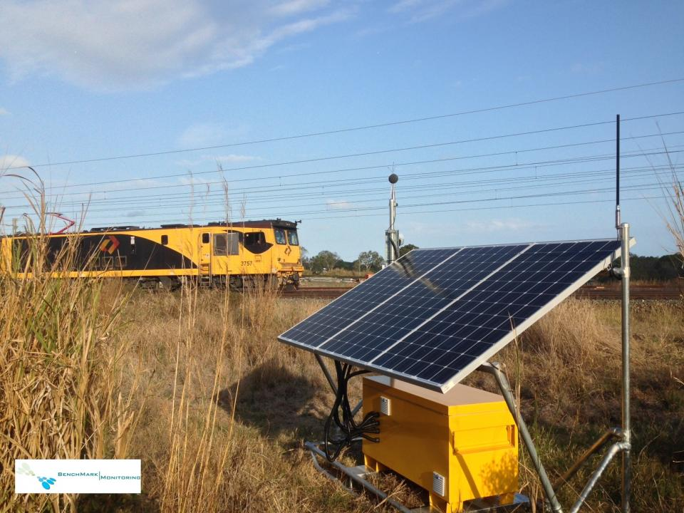
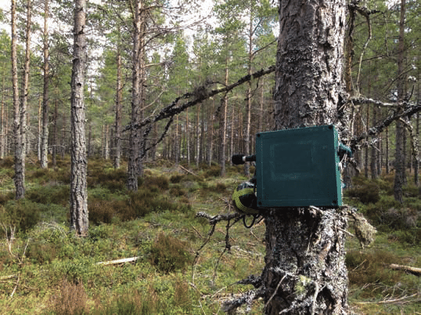
The Contexts : Environmental Sound Identification
For Industrial Noise Management
For Environmental Management
Notes:
This is a field based on using machine learning models to identify sources of noise. A monitor unit is installed in a particular environment, where it records and analyses detailed sound levels. This has many different applications. In heavy industry, it can monitor industrial noise pollution or track heavy vehicle movements. Environmental applications include surveying bird or frog populations and listening for illegal logging. So sound identification has a lot of socially and environmentally useful applications! But all of them require high quality sound data, which means voice and conversations will be recorded.
So what are they doing about it?

Slide 4
What is the Current Solution?
NOTHING!
Notes:
Pause

Slide 5



The Solution - Pre-Screening
Preprocessing
ML Model – Voice Yes / No
Does this contain voice data?
Raw Audio Data
Yes
No
Discard data
Continue routine assessment
Notes:
So we came up with a solution.
We propose to develop a simple machine learning model that can distinguish between audio with voice and audio without voice. The model would be installed on devices in the field, and would check data immediately after recording. If it identifies a voice sample, then that data is excluded from further analysis; if it doesn’t, the data goes through the process as normal. This means the monitor mostly functions as normal. But voice data is excluded at the earliest possible point in the process, and is never stored – so privacy impacts are minimised.

Slide 6



The Solution Details
Once sufficient data is cached (~5s), apply speech recognition model
Cache of input data
Input data 1/3 octave, short time step (<1 s, often 125 ms)
Speech recognised
No speech recognised
Cache data waiting for voice screening
Set data in cache to 0
(do not delete entry, just clear values)
Core data analysis/ML classification
Release cached data
Notes:
Here’s a more detailed view of the process. The monitor records data in small time steps (less than one second). However, successfully identifying voice data will require longer time steps. So the input data is put in a cache until there is enough to run our screening model. Once there is enough, run the screening – if it’s voice data, then set the values of the cache data to 0 and flag them as voice screened. Then release the cache into the monitor’s normal process.

Slide 7
Stakeholders
Power
Keep satisfied
Government
Manage closely
Audio monitoring manufacturers/operators
Audio ML developers
Monitor
Data customers
Audio monitoring customers
Keep informed
Public users
Interest
Notes:
We mapped out the stakeholders of the project. In the low power/low interest quadrant are customers of audio monitoring and data services. These are customers of our customers, and their primary concern is that the screening process has minimal impact on their business
In the low power/high interest quadrant are the general public – people who may be recorded by the monitors. Our primary goal is to protect their privacy.
In the high power/low interest quadrant is the government. Legal requirements could make our solution particularly desirable, or undesirable.

Slide 8
What We Bring to Target Customers
Protection
from legal concerns
Responsible practice
Less data to store
Notes:
All of these groups stand to benefit from our system, so long as their requirements are met:
· Assisting with responsible practice – they can use the privacy screening to promote themselves to potential customers or to the general public
· Reduced data collection – Less data means less storage space required and lower network bandwidth use
· Legal protections – they don’t have to worry about legal requirements for collecting and storing personal data. For example, some areas of the USA require ‘two-party consent’ for recording conversations – that is, everyone being recorded must give consent to the recording. Our solution would let noise monitors operate in these areas without worrying about potential legal issues.

Slide 9
A Viable and Responsible Solution
For customers
For the public
Minimal power usage
Minimal computation required
Traceability
No marginalised voice types
Balance between privacy and surveillance benefits
Notes:
To meet our customers’ needs, there are a few design constraints we need to consider:
· Minimal computation and power usage. Our system will run on devices in the field, which are likely to have only limited battery charge and computational power. Our model should be able to run on these devices without impacting their normal operation.
· Traceability. It should be clear when data was excluded due to the screening process (as opposed to a device fault, for example).
As well as our customers’ requirements, there are a few things we should keep in mind to ensure our system is socially responsible:
· Avoid marginalising anyone – ideally our system would work equally well detecting male and female voices across all languages and accents. We should use a diverse set of training data, and if the screening process doesn’t work as well for certain groups, we should make sure our stakeholders are informed.
· What happens if capturing voice data is desirable? For example, the monitor might record a crime. Screening out this data means erasing evidence. Whether the social benefits outweigh the privacy concerns depends on the culture – there isn’t one right answer.
In summary, environmental sound identification is a new field with many applications. However, it has the potential to impact privacy of people in the vicinity. Our screening system would minimise privacy impacts and help sound identification operate in a more ethical and responsible way.

Slide 10

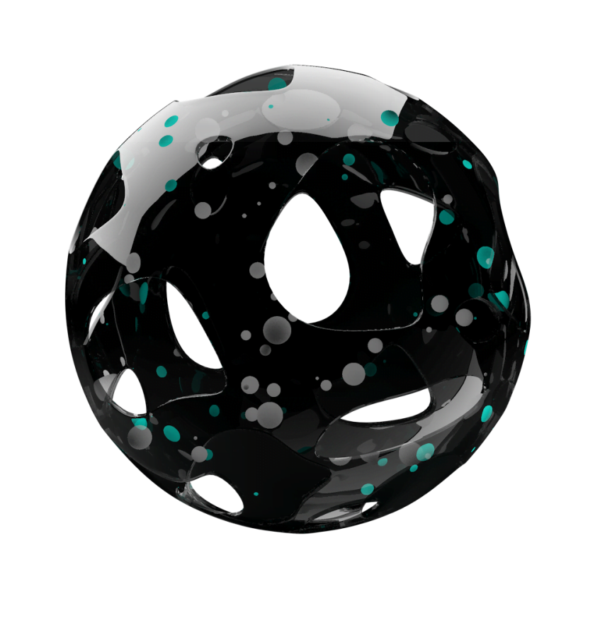
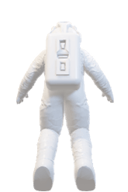
THA
NKS

